Slide 1
The Origin of Goals, Plans and Symbols..
Randall C. O’Reilly
University of Colorado Boulder
University of California Davis
eCortex, Inc

Slide 2
Models of What We Want
We learn a model of the environment, and of ourselves (model-based).
And use these models to get what we want (goal-driven).
Takes a lot of time and error-signals to train up these models – unlikely to emerge from simple reinforcement learning.

Slide 3
Inverting Forward Model
Forward: State + Action -> Outcome
This is easy, predictive learning
Inverse: State + Outcome* -> Action
This seems easy, but isn’t

Slide 4
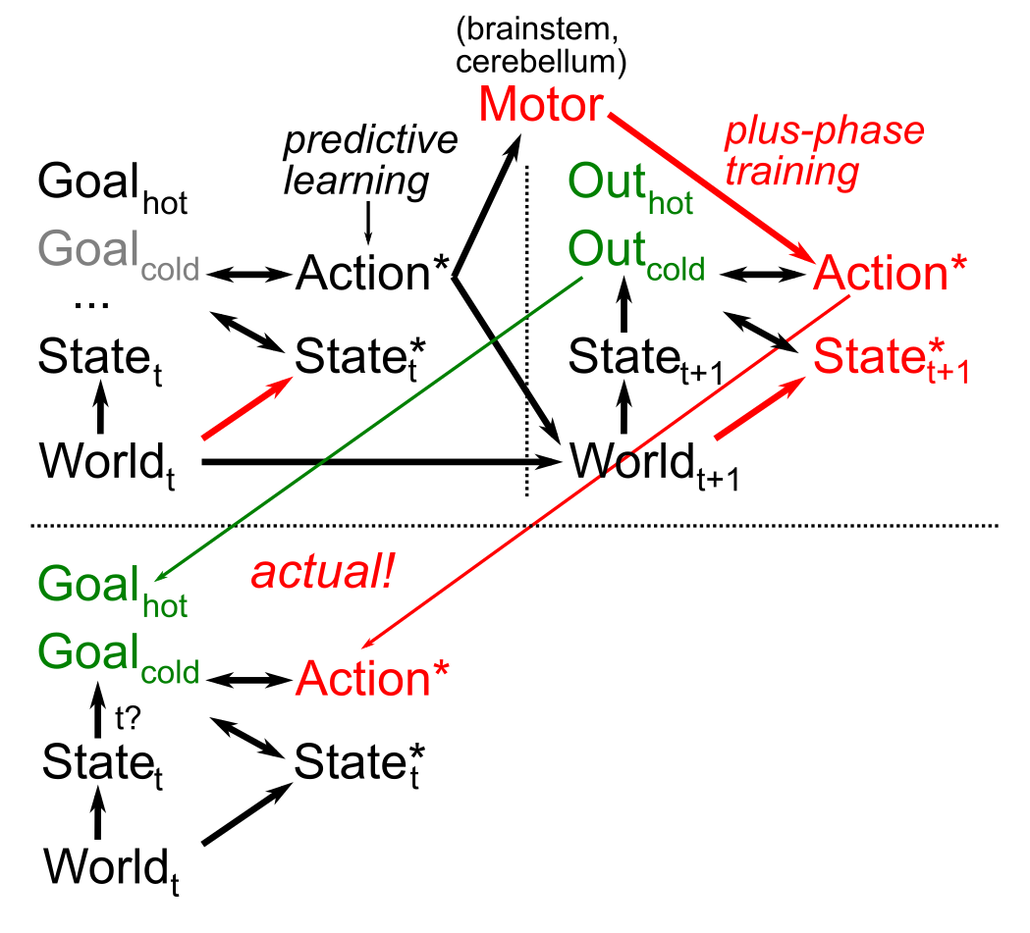
Goals, Motor Modeling
“predict” motor action you just took!
Same predictive learning mechanisms applied to forward and inverse sensory-motor learning.

Slide 5
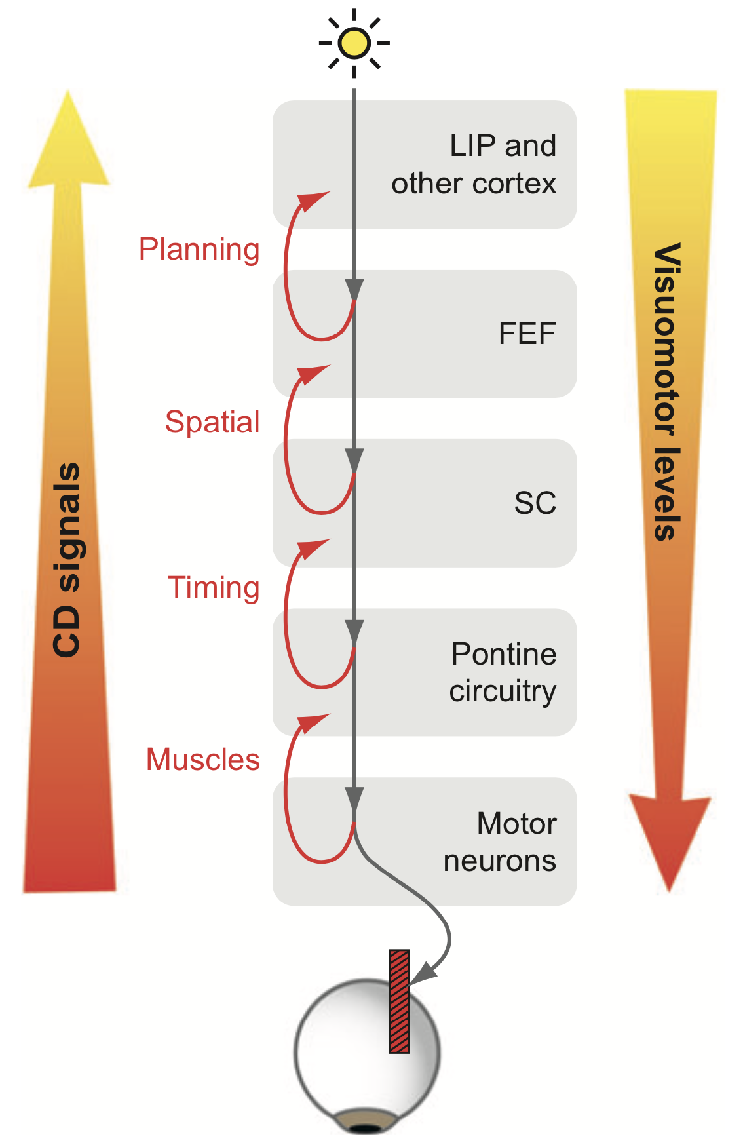
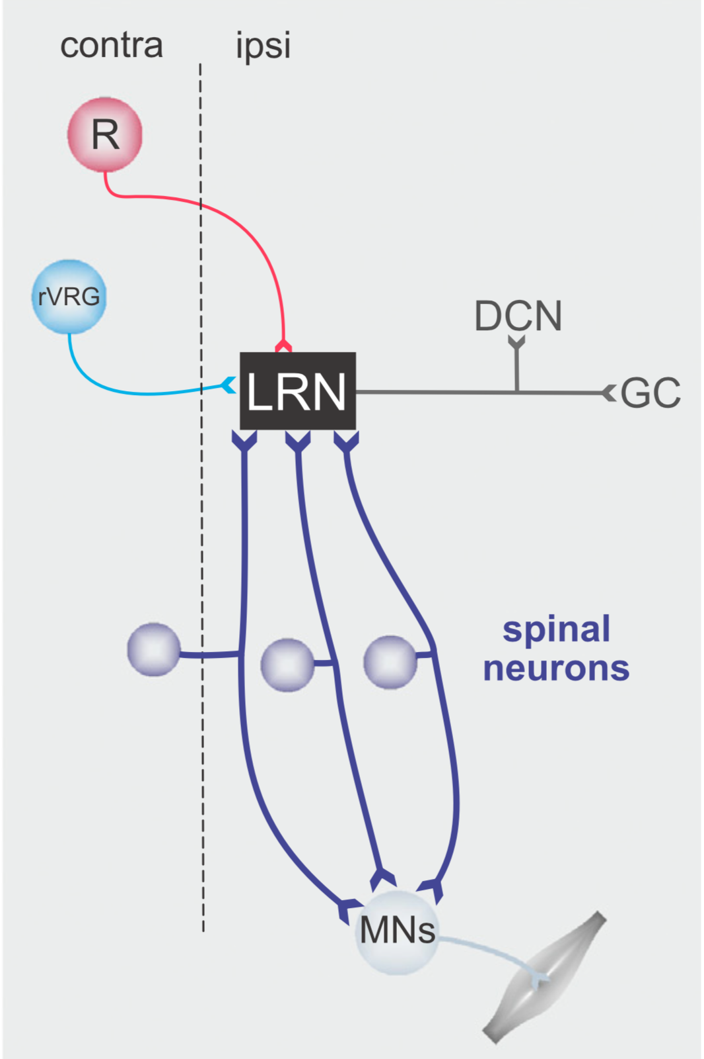
Efferent Copy / Corollary Discharge (Sommer & Wurtz, 2008; Pivetta et al, 2014; Azim et al, 2014)

Slide 6
Interim Summary
Learn to predict efferent copy of motor action
= State + Outcome -> Action*
Allows goal-driven behavior:
= State + Goal -> Action*
Still requires goal selection!

Slide 7
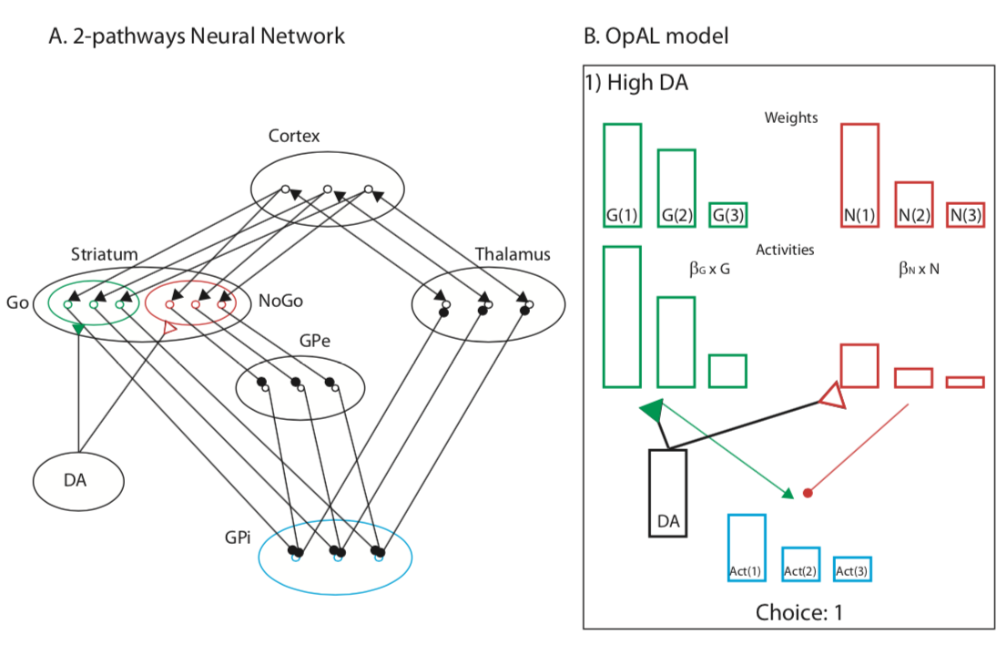
Decision-Making in Basal Ganglia (Collins & Frank, 2014)
Each option has a dedicated BG circuit??

Slide 8
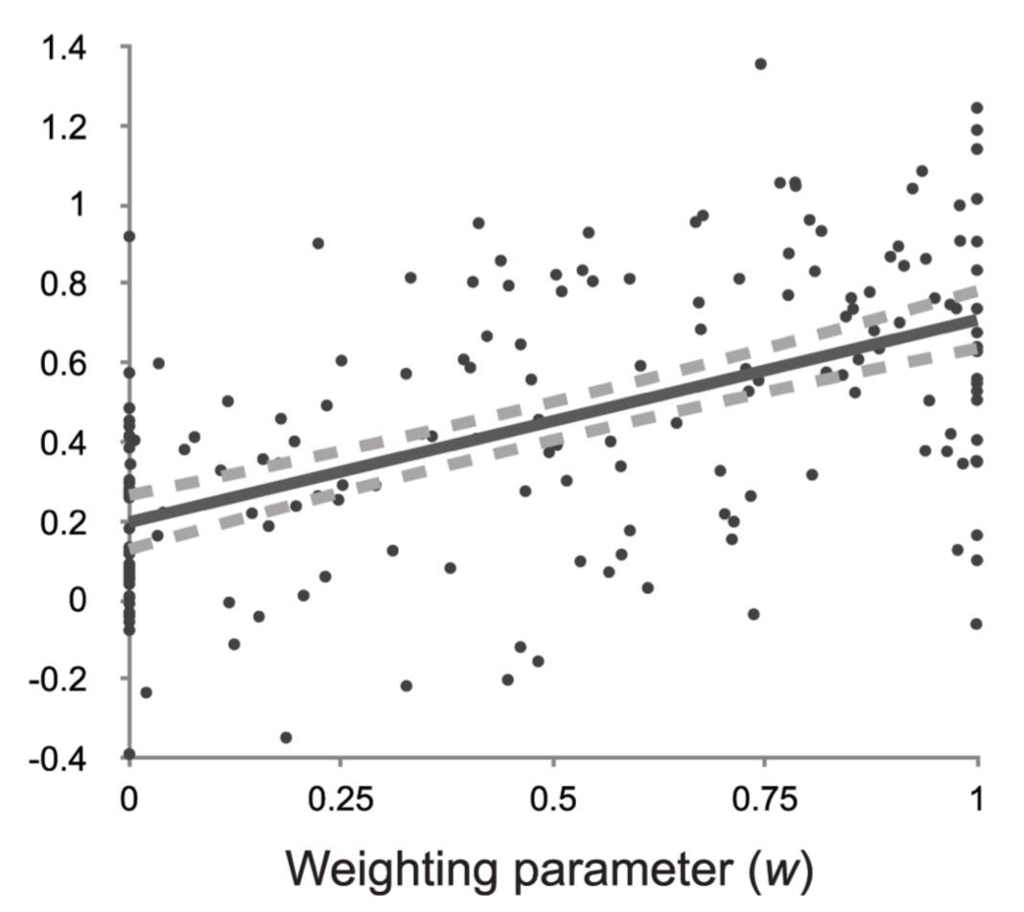
Model-based vs. Model-free
Actual data (e.g., Kool et al, 2016) shows a complex mixture of both (0 < w < 1)

Slide 9
Biologically-based Motivated DM Proposer – Predictor – Actor – Critic
Many sequential steps
BG / DA “gates” each
(BG = production firing, e.g., ACT-R; action selection in animal models)
Compounding of individual differences
Herd, Krueger, Nair, Mollick, & O’Reilly (submitted*)

Slide 10
Parallel vs. Serial
Turing machines are universal because they are serial (and it doesn’t take much hardware)
Conversely, some (large class of) problems cannot be solved in parallel (dependencies..)
To achieve universal flexibility, inherently parallel neural processing must be come serial

Slide 11
More Serial Advantages
Solving novel tasks requires novel combinations of existing subroutines (or new subroutines, which is much harder)
Serialization allows generic recombination of subroutines.
Parallel processing requires separate hardware for each routine, and connecting them is tricky..

Slide 12
Parallel is great too..
Fast, high-dimensional constraint satisfaction
Parallel gradient search learning: pursue many different solutions in parallel (serial search takes until the end of the universe..)
The human brain is the best known combination of parallel and serial processing! (animals are too parallel)

Slide 13
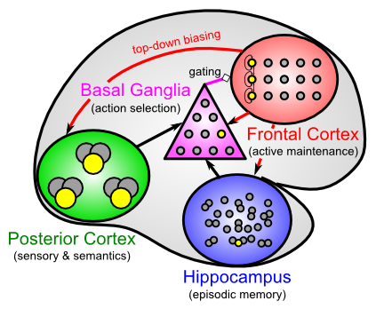
The Biological Architecture
PC is parallel
BG / FC enables serial via gating and active task maintenance
Hippo is fast, high-capacity memory cache

Slide 14
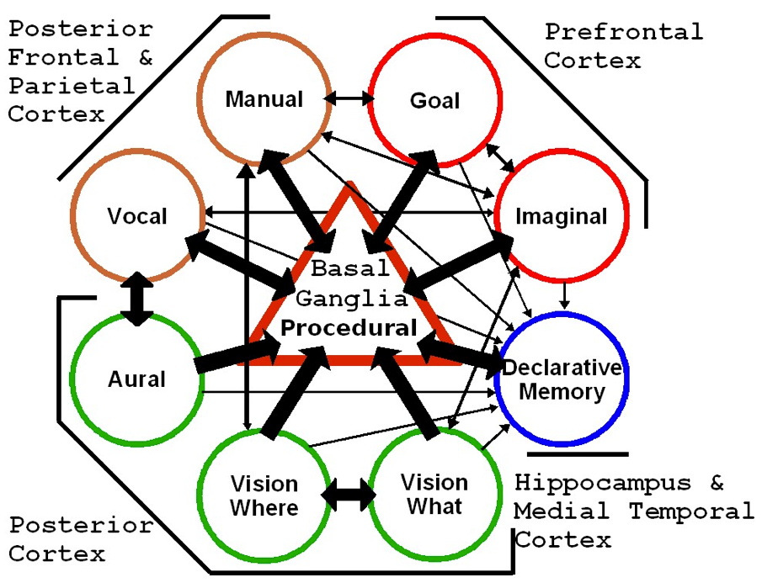
Proof of Concept: ACT-R
BG production system forces serialization -> flexible combination of productions. Goal buffer & declarative memory coordinate.

Slide 15
PBWM System (bio LSTM)
Three levels of modulation to get anything done..

Slide 16
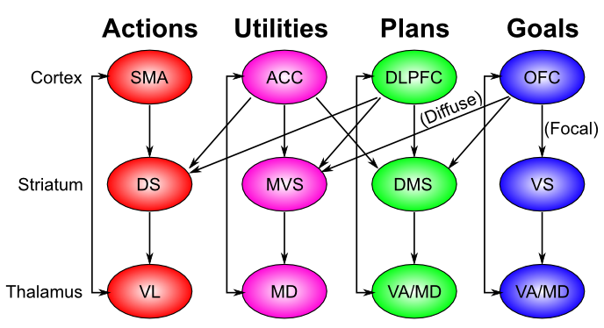
PFC is Exec, driven by bottom line..

Slide 17
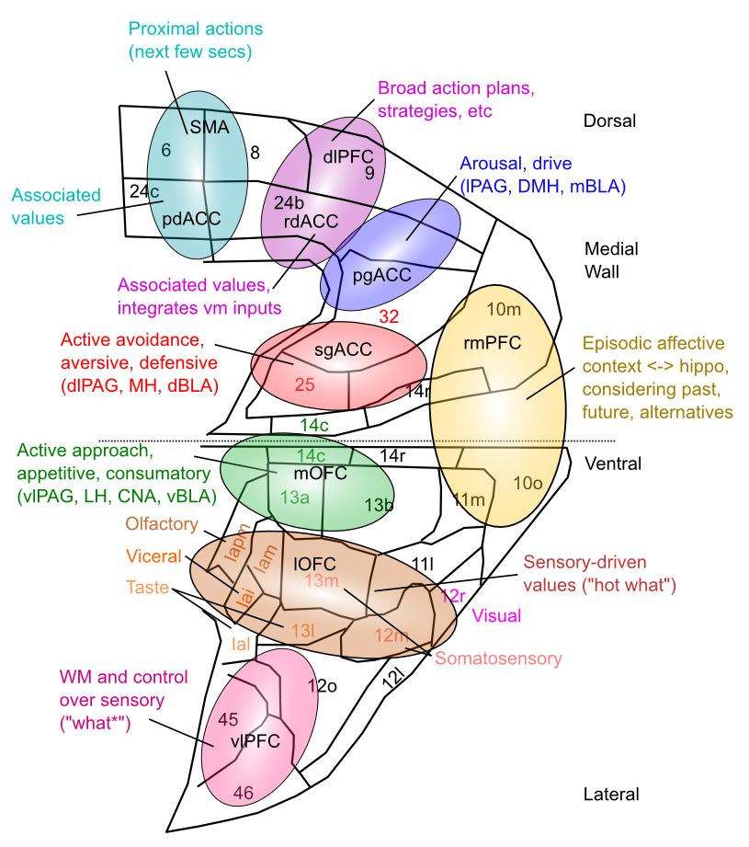
Medial Frontal Map of Values This is your emotional life

Slide 18
Serial vs. Parallel Summary
People can approximate a Turing machine by using LSTM-like BG/PFC gating & working memory (cf. “Neural Turing Machines”, Graves..)
Essential for combinatorial flexibility: recombining existing subroutines to do novel tasks
While still leveraging huge advantages of parallel learning and processing..

Slide 19
The 3R’s of Serial Processing
Reduce binding errors by serial processing: spatial attention spotlight – eg DCNN’s that focus on object BBox – less adversarial image issues..
Reuse same neural tissue across many different situations – improved generalization (e.g., RN)
Recycle activity throughout network to coordinate all areas on one thing at a time: consciousness

Slide 20
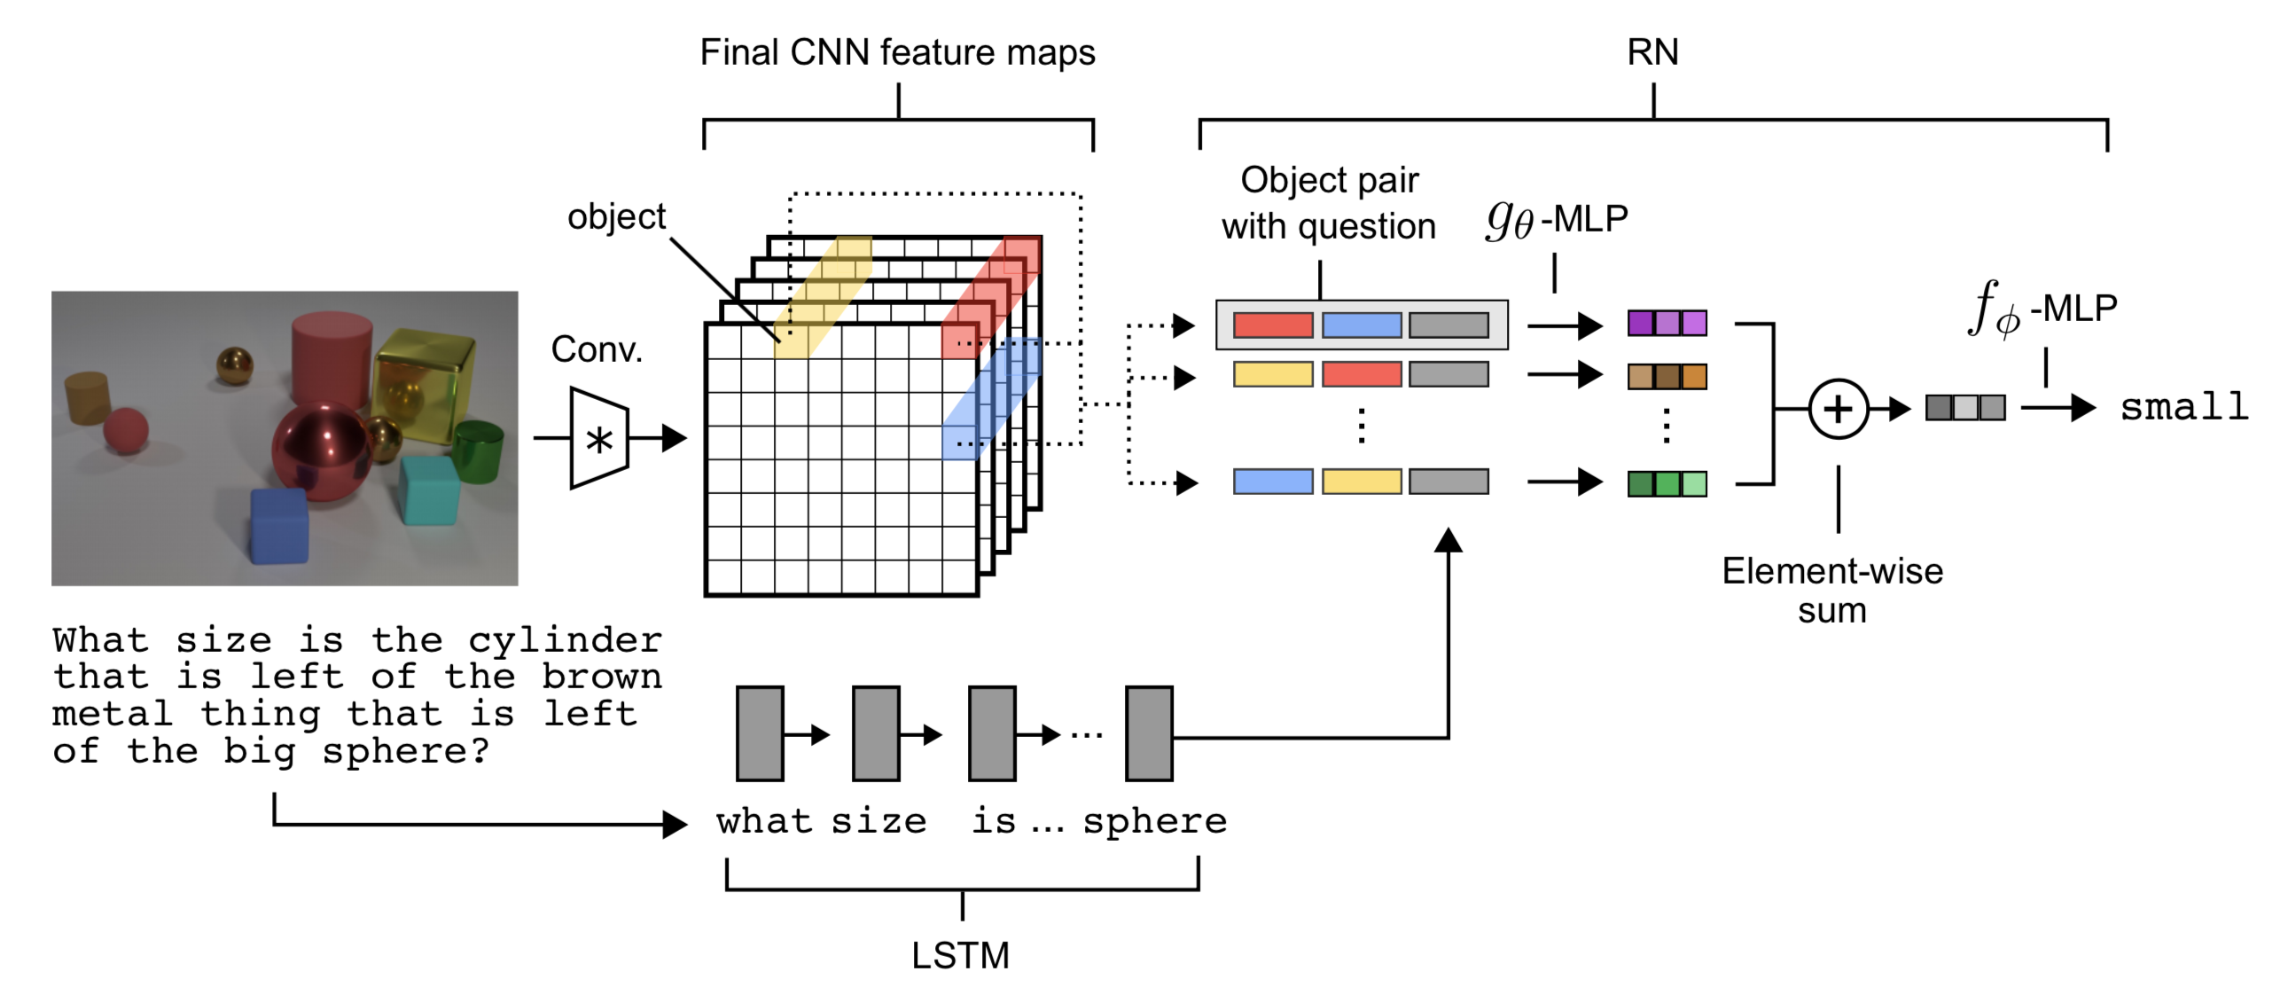
Relational Network (Santoro et al)
RN reuses same low-dimensional (pairwise) weights for all possible comparisons (using convolutional shared weights, in parallel).
But cannot generalize outside of training set (no combinatorial gen..)

Slide 21
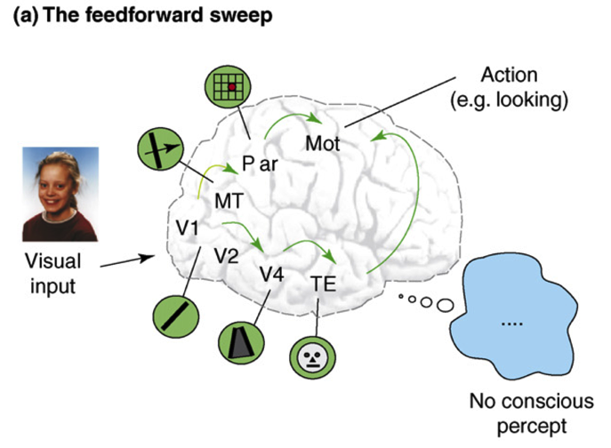
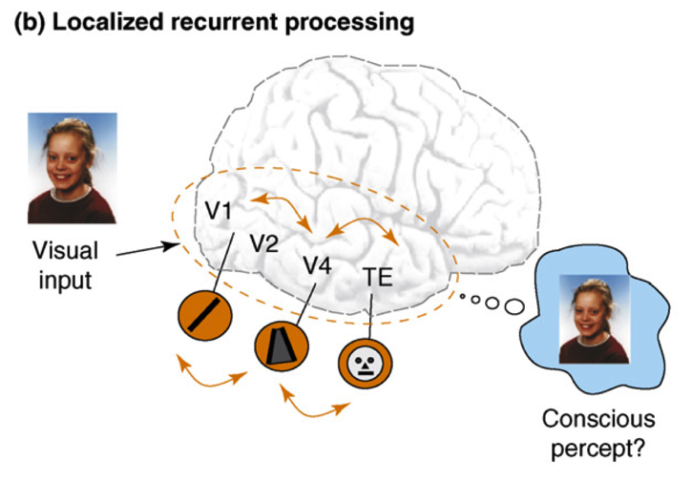
Recurrent Processing -> Consciousness (Lamme, 2006; cf. Bengio 2017)
Consciousness is Unitary
Recurrence coordinates all areas on one thing (emerges via popular vote)
Consciousness is Functional
Helps organize, prioritize behavior – “focusing” key for difficult problems
Consciousness Flows
Temporal dynamics and information processing (multi-step cognition)

Slide 22
Recurrent Processing
Current DCNN’s are almost exclusively feedforward
Cortex is massively recurrent (bidirectional excitatory connections)
Leabra model uses bidirectional excitatory connections to drive error-driven learning (O’Reilly, 1996) and constraint satisfaction (ala Hopfield)

Slide 23
Remaining Mysteries
How do we learn a full combinatorial vocabulary of productive subroutines?
What is the API? How do they communicate? Language, spatial attention spotlight..
Cognitive sequencing, planning: how do we write programs on the fly in our brains??

Slide 24
Thanks To
CCN Lab
Tom Hazy
Seth Herd
Tren Huang
Dave Jilk (eCortex)
Nick Ketz
Trent Kriete
Kai Krueger
Scott Mackie
Brian Mingus
Jessica Mollick
Wolfgang Pauli
John Rohrlich
Sergio Verduzco-Flores
Dean Wyatte
Funding
ONR – Hawkins

Slide 25
Extras

